Slide 1
AONB access roads
All HGV journey numbers taken from Environmental Survey
Assume compounds beyond Bowood Lane use B4009-A4129 route
Objective – to get HGVs off the A413 & onto the trace wherever possible
White Vans ( contractors) – we petitioned for an enforced “park & ride” scheme, so not consirered further here
Notes:
Vn 3 – New route sildes + SH, HW (5-Oct)
Vn 4 – Minor changes to 1st & last slides

Slide 2
Local Roads Inappropriate for HS2 construction traffic
Not strong enough (BCC report needed)
Too narrow
Too dangerous – conflict with
School busses
Walkers
Cyclists
Widespread congestion, particularly when Frith Hill closed
~150 properties on route
Noise/dust/vibration
Effect on health
Corner/hill too steep for HGVs, low loaders

Slide 4
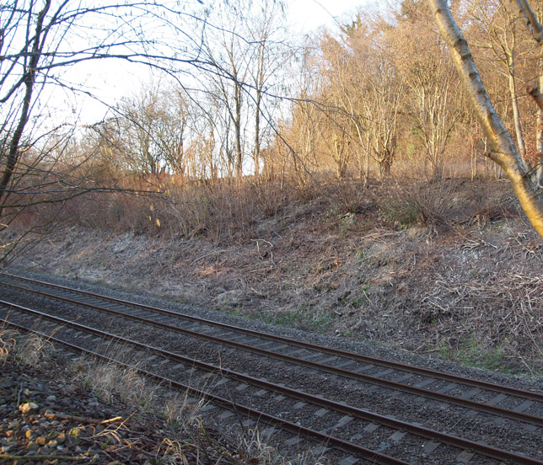
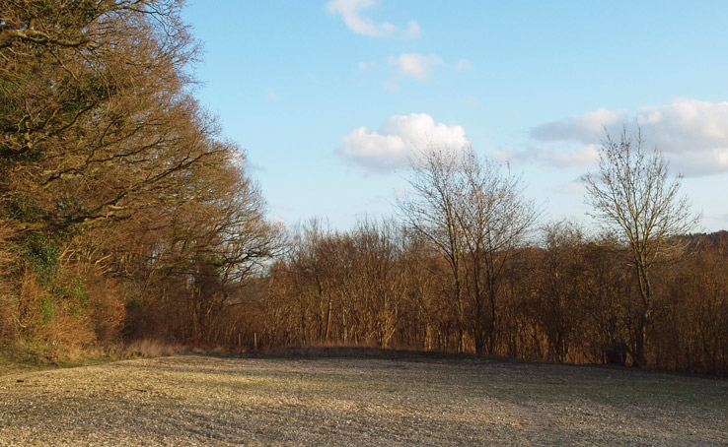
Mantles Wood – Deep Mill
Access to the portal (& balancing pond ?) , without passing through Mantles Wood
Possible site for a bridge over the Chiltern Line ➢
⋅ Corner of the field extending to the tunnel portal

Slide 5
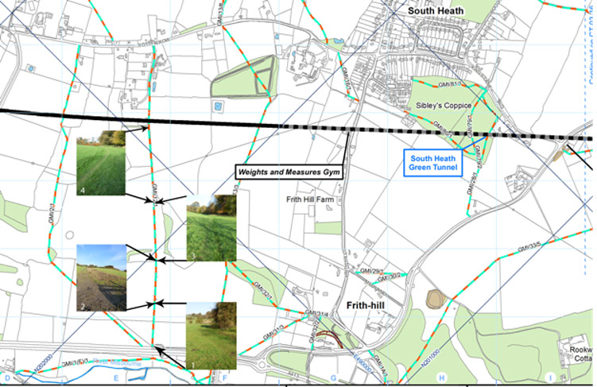
South Heath Tunnel Access – Route following GM20

Slide 6
Access roads & the trace
Hyde Heath Road
Potter Row
Kings La
HS2 TRACE
HS2
HS2 .
Frith Hill
B485
A413
Little Missenden
A413 .
Great Missenden

Slide 7
Key problem points
Too narrow to pass
Hyde Heath Road
Blind x-roads
Potter Row
Kings La
HS2 TRACE
HS2
HS2 .
Frith Hill
Traffic control crossing trace
B485
Too steep for HGV
A413
Little Missenden
A413 .
Deep Mill bridge
Great Missenden

Slide 8
Access as proposed by HS2
Chilterns Tunnel portal
Bowood & Leather Lanes
South Heath ‘green’ tunnel
Little Miss Vent Shaft
Hyde Heath Road
Potter Row
Kings La
30
HS2 TRACE
35
HS2
55
35
HS2 .
55
Frith Hill
B485
A413
Little Missenden
HGVs / day by compound
Deep Mill bridge
Great Missenden

Slide 9
Access as proposed by HS2
Chilterns Tunnel portal
Bowood & Leather Lanes
South Heath ‘green’ tunnel
Little Miss Vent Shaft
Hyde Heath Road
Potter Row
30
Kings La
30
HS2 TRACE
35
HS2
55
35
HS2 .
55
Frith Hill
210
B485
A413
155
Little Missenden
155
HGV trips per day in each direction
Deep Mill bridge
Great Missenden

Slide 10
Access with new Mantles Wood road
Chilterns Tunnel portal
Bowood & Leather Lanes
South Heath ‘green’ tunnel
Little Miss Vent Shaft
Hyde Heath Road
Potter Row
30
Kings La
30
HS2 TRACE
35
HS2
55
55
35
HS2 .
55
Frith Hill
210
B485
90
155
A413
65
Little Missenden
65
HGV trips per day in each direction
Deep Mill bridge
Great Missenden

Slide 11
Access with new Mantles Wood & S/Heath roads
Chilterns Tunnel portal
Bowood & Leather Lanes
South Heath ‘green’ tunnel
Little Miss Vent Shaft
Hyde Heath Road
Potter Row
Kings La
30
HS2 TRACE
35
HS2
55
55
35
HS2 .
55
Frith Hill
210
B485
90
155
65
A413
0
65
Little Missenden
65
HGV trips per day in each direction
Deep Mill bridge
Great Missenden

Slide 12
Saves the villages
Reduced numbers of HGVs on A413 –
2 x 90/day fewer – Deep Mill to B485
2 x 65/day more – between the B485 & Link Road
Impact on Great & Little Missenden otherwise unchanged
Villages saved from 7+ years destruction

