Slide 1
HS2 Amersham ( & Chesham ) AGs

Slide 2
Who we are
HS2 Amersham AG
Established group, still very active despite now being over a tunnel
Chesham Society
Local amenity society..
What we do
Raise Cash
Raise local awareness
Oppose HS2
Limited by available effort –
Not enough time, &
Not enough people

Slide 3
Raising Cash
Main focus of group / committee is raising and allocating funds

Slide 4
Raising Awareness
Most people have only a sketchy knowledge of the project, and a fatalistic attitude -
“It will happen anyway” .. whatever I do
“It will be cancelled” .. whatever I do
Need to be seen at any local events – Fetes, street markets, any HS2 consultation events
Organise own ( fund raising ) events
‘HS2 Shops’ – labour intensive, but higher profile

Slide 5
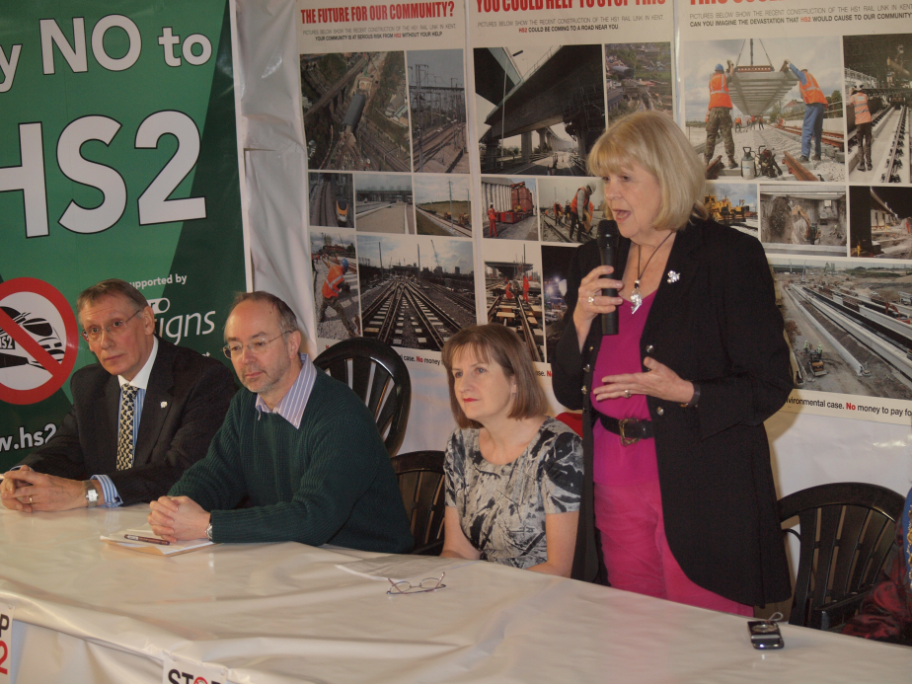
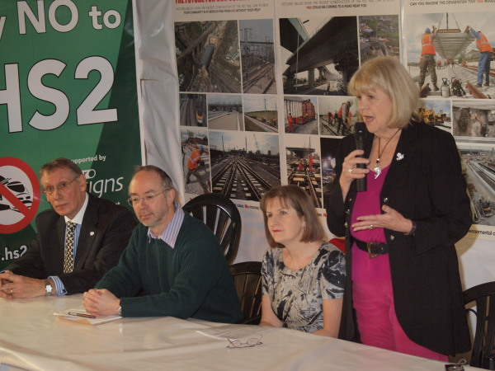
HS2 Shops
We have twice had the use of empty shops in Amersham, for several weeks.
Displays etc are seen by more people
Good venue for events ( JR press conference )
Can sell stuff – 200 club tickets, event tickets …
Overheads – setting up & staffing

Slide 6
Raising Awareness
Most people have only a sketchy knowledge of the project, and a fatalistic attitude -
“It will happen anyway” .. whatever I do
“It will be cancelled” .. whatever I do
Need to be seen at any local events – Fetes, street markets, any HS2 consultation events
Organise own ( fund raising ) events
‘HS2 Shops’ – labour intensive, but higher profile
Local amenity societies – join , get elected. They have resources –
Communications network
Charitable status
Stuff – Gazebos, Display boards, Money ?
… but, more meetings ☹

Slide 7
Opposing HS2
Doesn’t take much committee time – organised by Email
Community Forums – Bucks CC arranges a pre-meeting ( of all groups ) to plan for the next meeting & draw up the Agenda
(Many) other meetings – attended by the usual suspects, depends who is available.
HS2 Consultations –
providing & circulating suggested responses
Setting up alternative displays at Roadshows

Slide 8
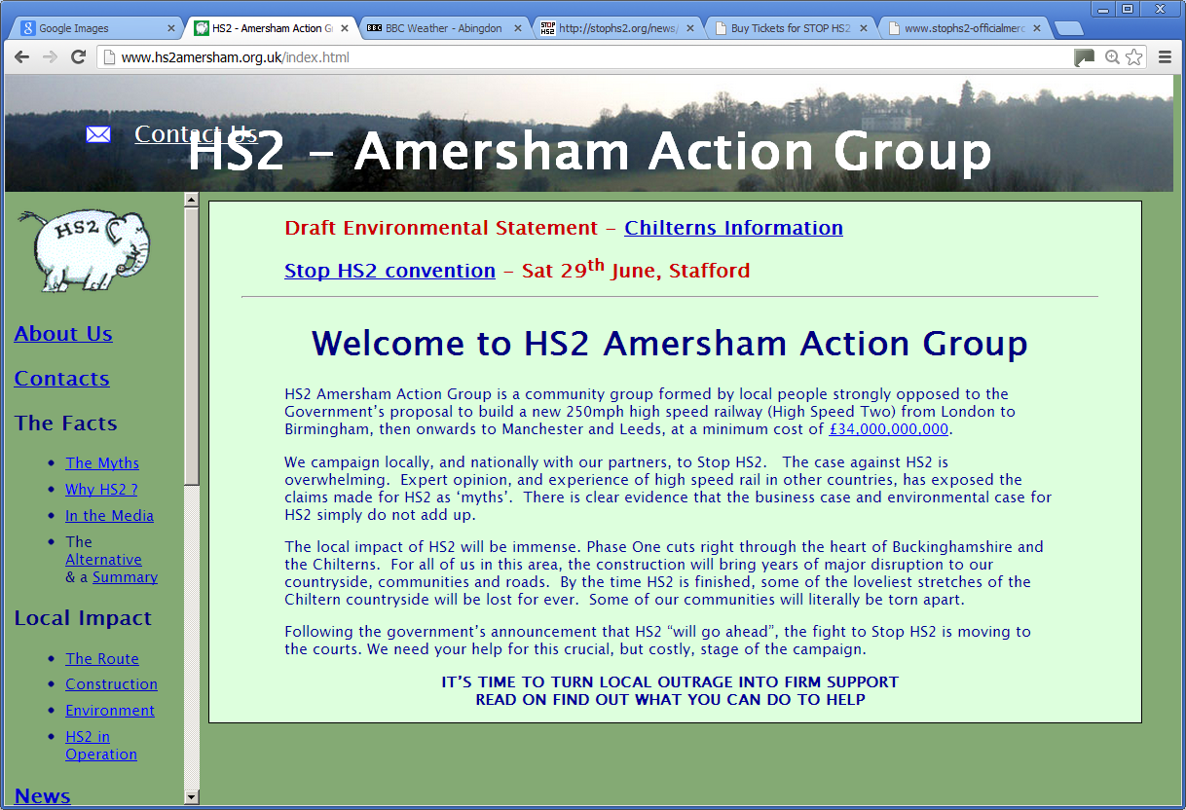
Website
A useful resource –

Slide 9
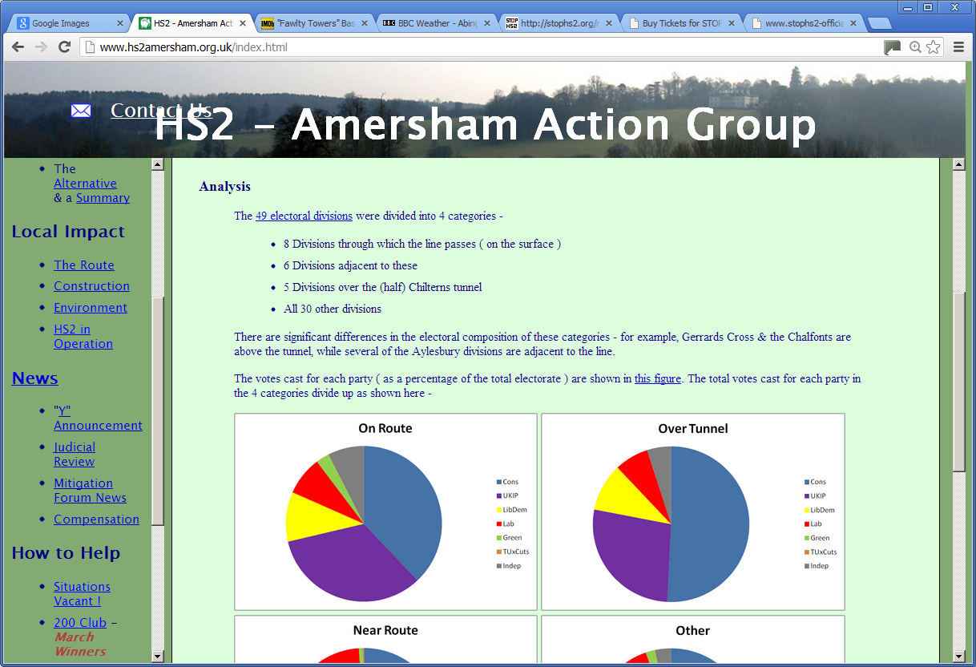
Website
A useful resource –
To promote our events
Source of local ( & some national ) news
A permanent ( & searchable ) record of
CF documents, presentations, minutes etc
Local Maps ( in manageable chunks )
Newsletters – ours & other local groups

Slide 10
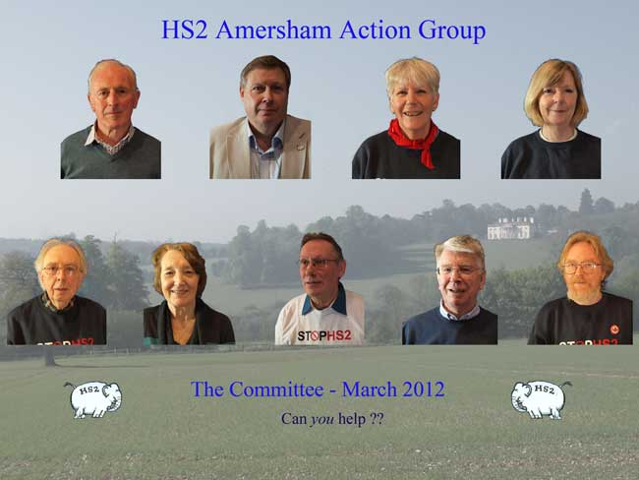
‘Organisation’
Committee – around 8 – meets every 4 to 6 weeks

Slide 11
‘Organisation’
Committee – around 8 – meets every 4 to 6 weeks
“Friends” – a dozen or so – help out with events
Mailing list – a few hundred – of limited use
The committee
Decides what events to stage ( owner, budget )
Decides how to distribute funds
Avoids ( national ) politics
Annual(ish) meeting
Everyone invited
Mostly informative, no decisions, elections etc
Legal structure
Bank Account ( 2 sigs )
Public Liability Insurance

